Slide 1



1st International Conference on LWR Fuel Performance, Modelling and Experimental Support
Spent Nuclear Fuel Management of Ukrainian Nuclear Operator
Roman Glushenkov
Leading engineer of the fuel management section
JSC “NNEGC “Energoatom”
14-19 September 2025, Nessebar, Bulgaria

Slide 2
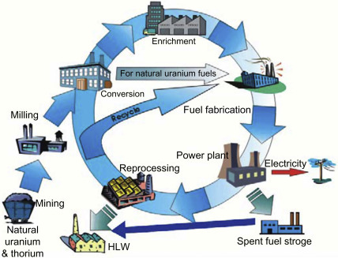
SPENT NUCLEAR FUEL MANAGEMENT
2
The way a country manages its spent nuclear fuel is primarily determined by the type of nuclear fuel cycle it applies, which is widely categorized into two main approaches:
Open.
Closed.
There are several strategies for the final stage of the fuel cycle (spent fuel management):
Spent fuel reprocessing: this process involves chemically separating reusable uranium and plutonium from spent fuel so they can be returned to the fuel cycle. The highly radioactive fission products are isolated as high-level waste, which then requires long-term storage.
Deferred solution: This approach involves storing spent fuel in temporary facilities, either at NPP sites or at centralized interim storage facilities, without immediate reprocessing or permanent disposal.
Direct disposal: this strategy involves preparing spent fuel (after optional interim storage) for direct emplacement in deep geological repositories without prior reprocessing.

Slide 3
3
SPENT NUCLEAR FUEL MANAGEMENT
Country | Deferred solution | Direct disposal | Reprocessing
Belgium | + | - | +*
Slovakia | + | - | -
Czech Republic | + | - | -
Hungary | + | - | -
United Kingdom | - | + | +*
India | - | - | +*
USA | - | + | +*
Ukraine | + | - | -
Canada | - | + | -
China | - | - | +
Germany | - | + | +*
russia federation | - | - | +
Finland | - | + | -
France | - | - | +
Sweden | - | + | -
Japan | - | - | +
* - partial reprocessing
Many countries have not yet decided and continue to store SNF until a final strategy is chosen (the so-called "deferred decision")

Slide 4
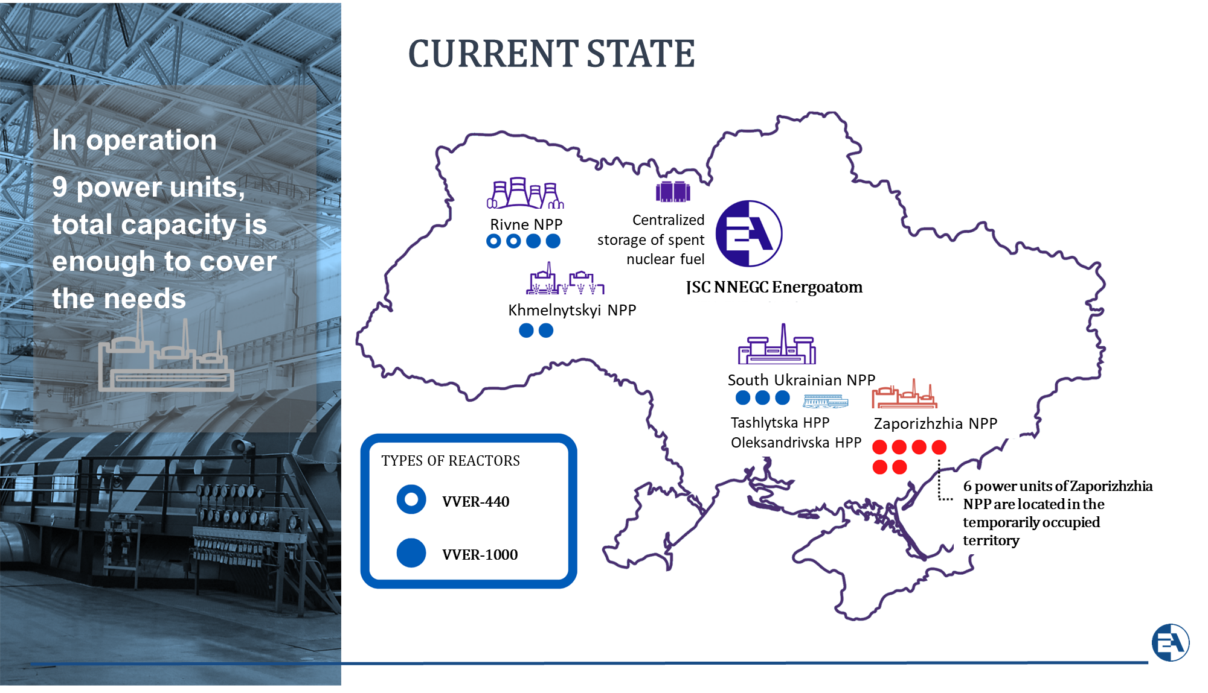
JSC “NNEGC ”ENERGOATOM”
4

Slide 5
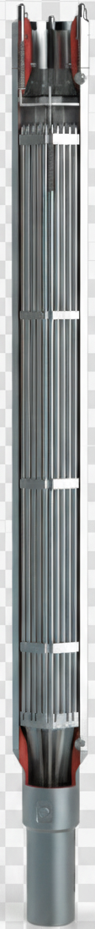
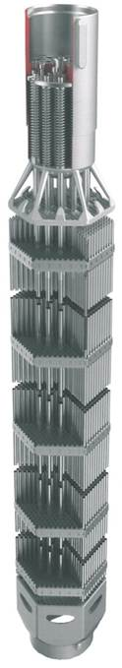
NUCLEAR FUEL
5
Nuclear fuel management is an integral part of the technological process of electricity production.
Energoatom supplies nuclear fuel produced by Westinghouse for all of its units. RWFA for VVER-1000 and NOVA E-5/NOVCC for VVER-440.
Energoatom’s nuclear fuel management is completely independent of the russian federation.
Energoatom is a participant of the APIS project. APIS is Accelerated Program for Implementation of secure VVER fuel Supply, indicating that the European countries operating VVER reactors have an urgent need to qualify an alternative fuel supplier to secure the future power generation.

Slide 6
RETROSPECTIVE ENERGOATOM’S NUCLEAR FUEL MANAGEMENT
6
Westinghouse Electric Sweden AB
JSC “NNEGC “Energoatom”
JSC “TVEL”:
JSC “Mashinostroitelny Zavod”
(c.Elektrostal)
JSC “Novosibirsk Chemical Concentrates Plant”
(c. Novosibirsk)
RNPP
SUNPP
KhNPP
ZNPP
Technological storage and reprocessing
PA “Mayak”,
c. Chelyabinsk
SNF
VVER-440
On-site Dry Spent
Fuel Storage
Facility
PA “MCC”,
c. Zheleznogorsk
Centralized Spent
Nuclear Fuel Storage
Facility
(Chernobyl Exclusion Zone)
SNF
VVER-1000
HIGH-LEVEL
RADIOACTIVE WASTES
HLRW storage
(Chernobyl Exclusion Zone)
- Practice
- Plans
COMPLETE DEPENDENCE ON THE RUSSIAN FEDERATION!

Slide 7
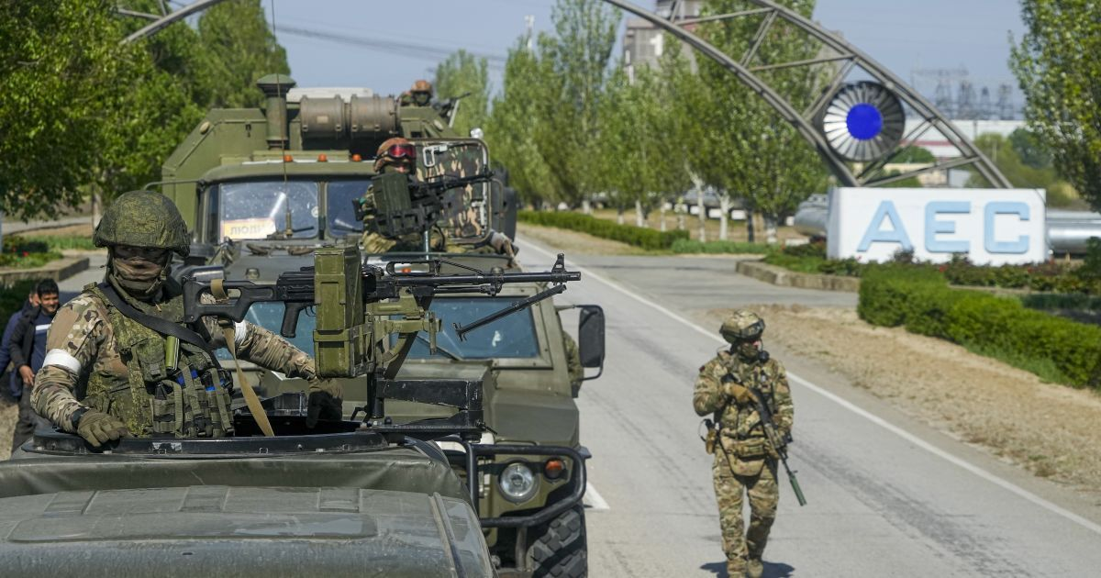
ENERGOATOM’S NUCLEAR FUEL MANAGEMENT
7
Westinghouse Electric Sweden AB
JSC “NNEGC “Energoatom”
RNPP
SUNPP
KhNPP
ZNPP
ZNPP was occupied by russian troops on March 4, 2022, during the full-scale russian invasion
Centralized Spent
Nuclear Fuel Storage
Facility
(first container in 2023)
On-site Dry Spent Fuel Storage Facility
(first container in 2001)
Deferred solution:

Slide 8
ENERGOATOM’S SPENT NUCLEAR FUEL MANAGEMENT
8
ZNPP
SUNPP
KhNPP
RNPP
Spent fuel pool
Spent fuel pool
Spent fuel pool
Spent fuel pool
SNF cooling
On-site Dry SNF Storage Facility:
Storage for 50 years of 380 containers with 24 VVER-1000 SFAs each (MTL max 23,76 kWt)
Centralized SNF Storage Facility:
Storage for 100 years of 458 containers:
- 388 containers with 31 SFAs each from VVER-1000
(zoned configuration, MTL max 38kWt)
- 70 containers with 85 SFAs each from VVER-440
(zoned configuration, MTL max 33kWt)
Long-term storage
Spent fuel reprocessing
Deferred solution:
Direct disposal
?

Slide 9
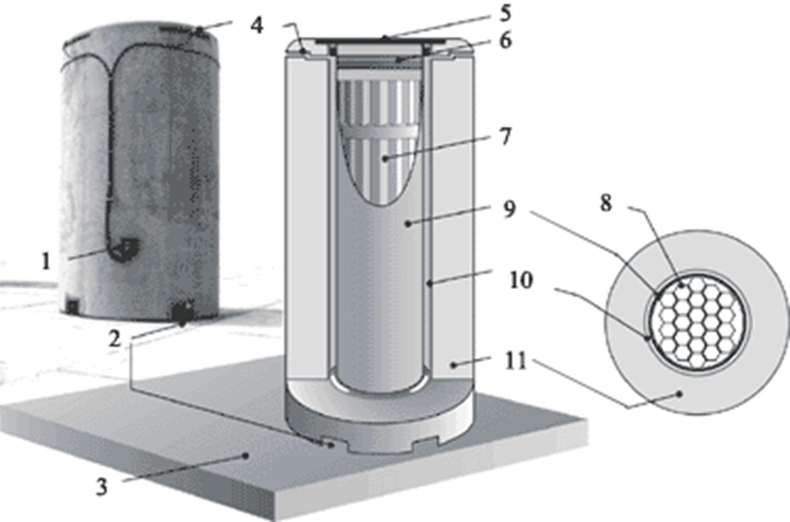
ZNPP On-site Dry Spent Fuel Storage Facility
9
The facility is located at Zaporizhzhia NPP.
The design of Sierra Nuclear Corporation and Duke Engineering & Services was selected.
The fuel is stored in sealed canisters, where the VVER-1000 fuel is in an inert gas environment. The canister is placed through reloading container inside an air ventilated concreate container for long-term (50 years) storage.
Temperature monitoring sensor. Air inlet. Concrete storage pad. Air outlet. Concrete container lid. Forced and protective lids of the canister. Cells for spent fuel assemblies. Cell for spent nuclear fuel. Canister body. Shell. Ventilated concrete container.
9

Slide 10
ZNPP On-site Dry Spent Fuel Storage Facility
10
SNF
Crossbeam
Canister
SF pool
SF pool
Reloading container
Decontamination zone
Placing the canister inside the reloading container
Placing the reloading container inside a spent fuel pool
Placing the SNF inside the canister, installing the protective lid
Transportation, decontamination, vacuum drying, lids welding, helium filling
Container carrier
Transportation to the facility
Installation at the facility
Placing the canister inside the container

Slide 11
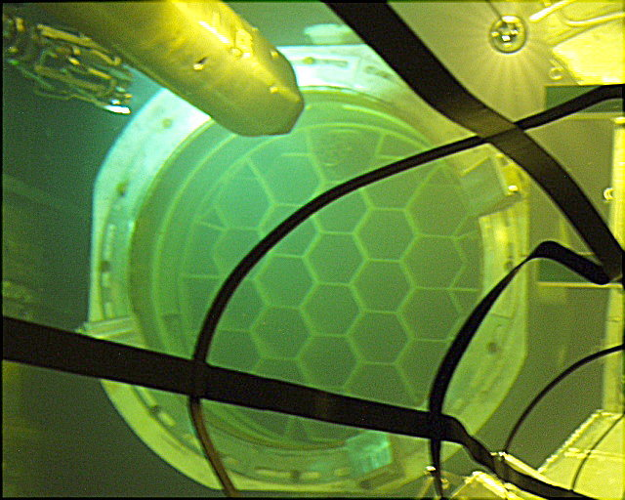
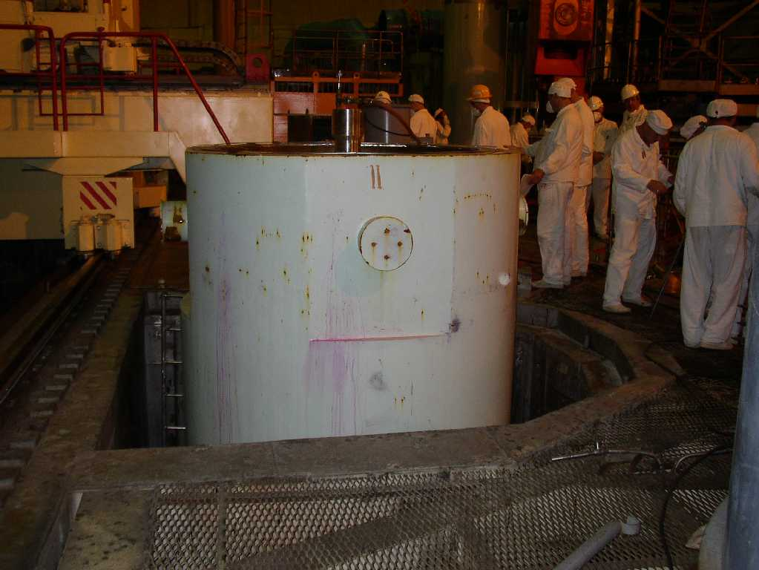
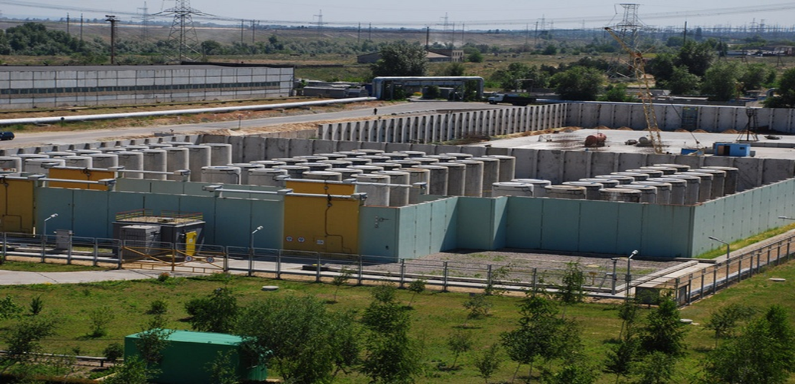
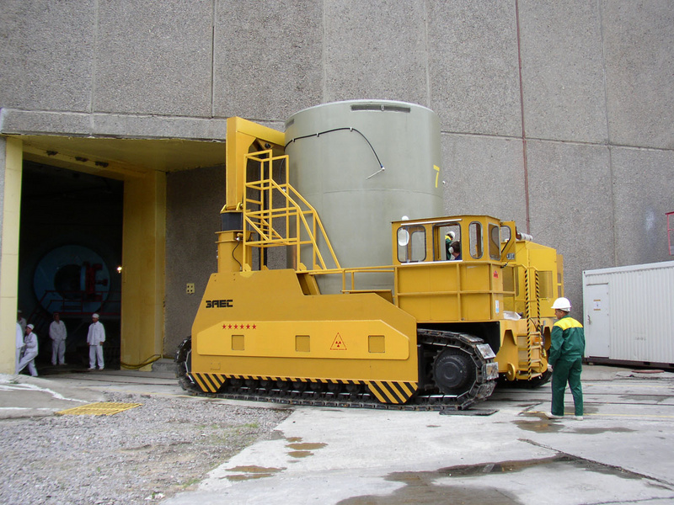
ZNPP On-site Dry Spent Fuel Storage Facility
11

Slide 12
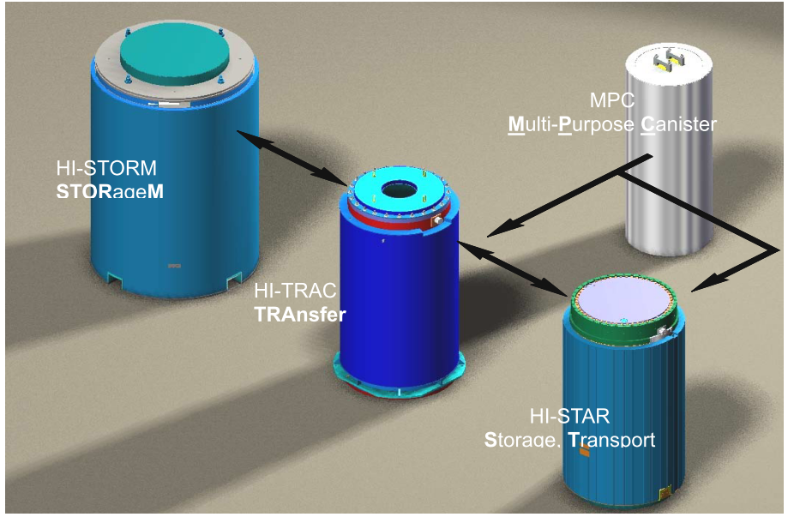
CENTRALIZED SPENT NUCLEAR FUEL STORAGE FACILITY
The facility is located in the Chernobyl Exclusion Zone.
The design of Holtec International was selected.
The facility is designed for storage of VVER-1000 and VVER-440 spent nuclear fuel from three NPPs.
SNF is stored in Multi-Purpose Canisters (MPC) filled with inert gas environment.
MPC is placed through HI-TRACK container inside a transportation and storage HI-STAR container for the transportation to the facility.
At the facility MPCs are reloaded to air-ventilated HI-STORM containers for long-term (100 years) storage.
12

Slide 13
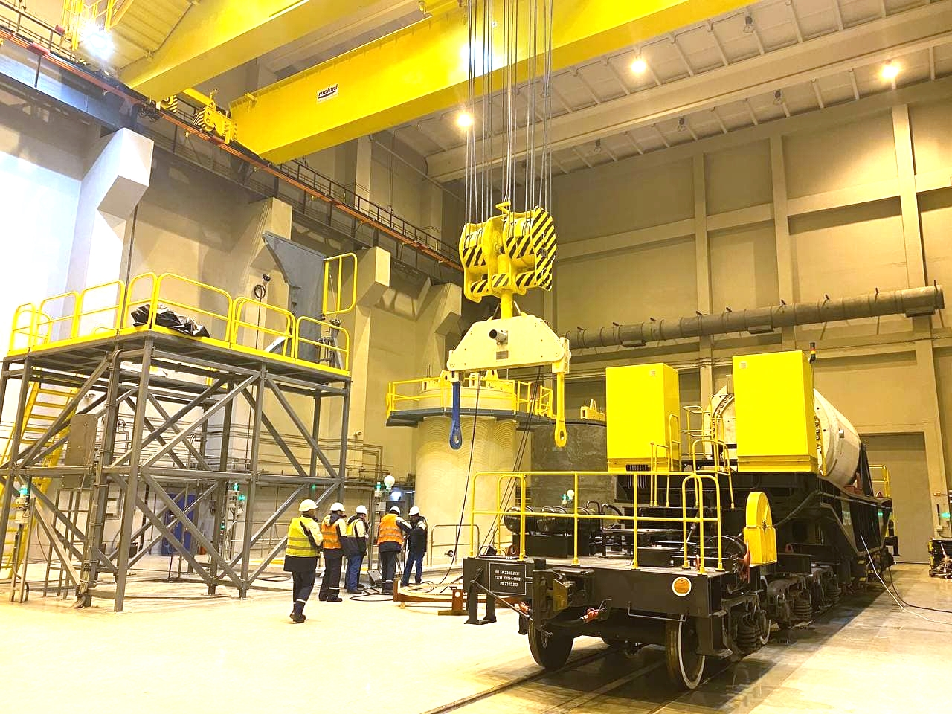
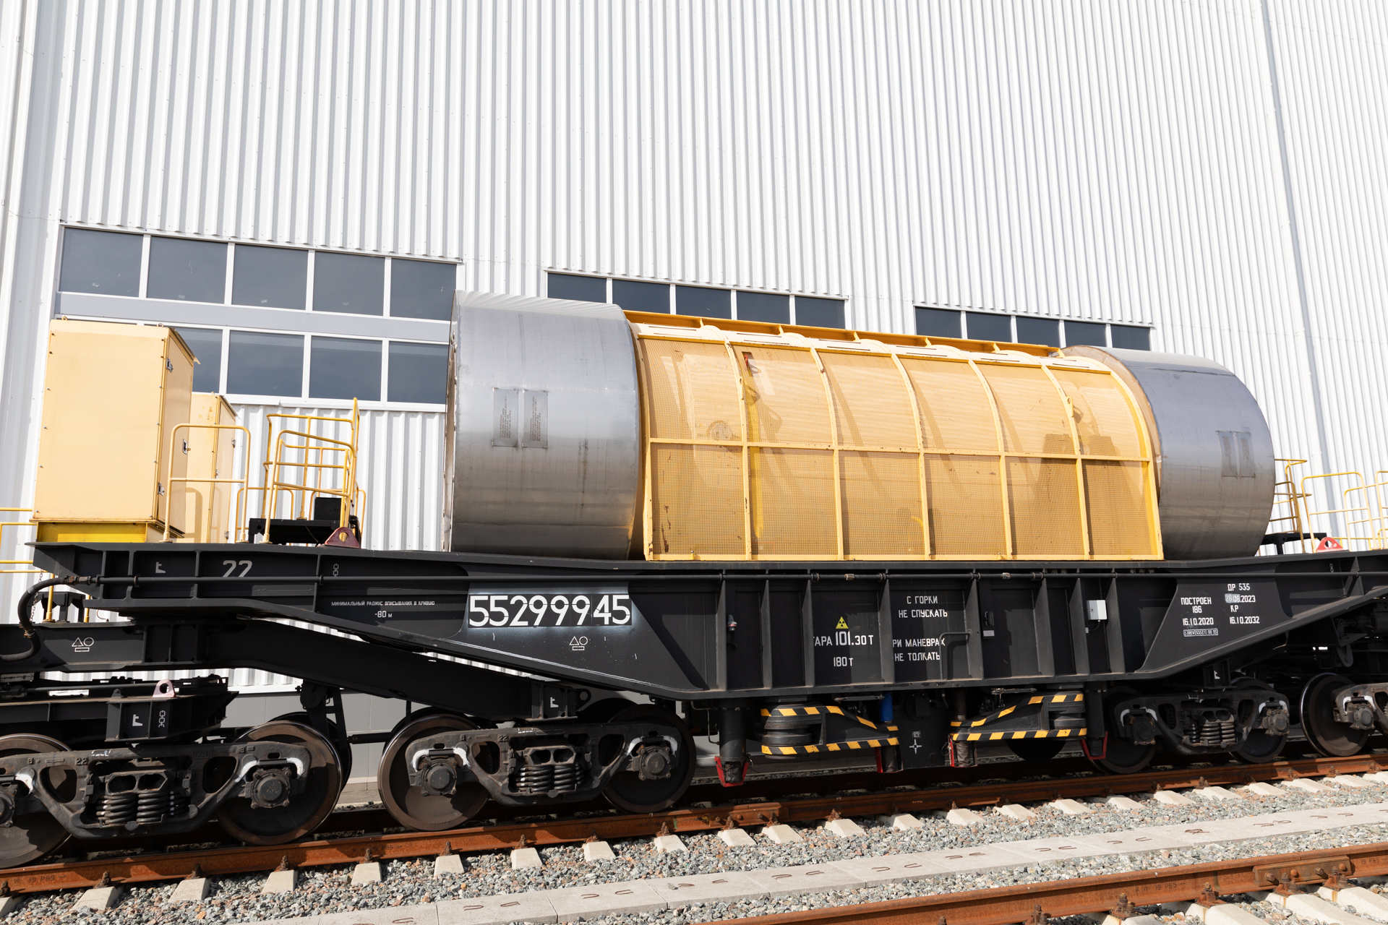
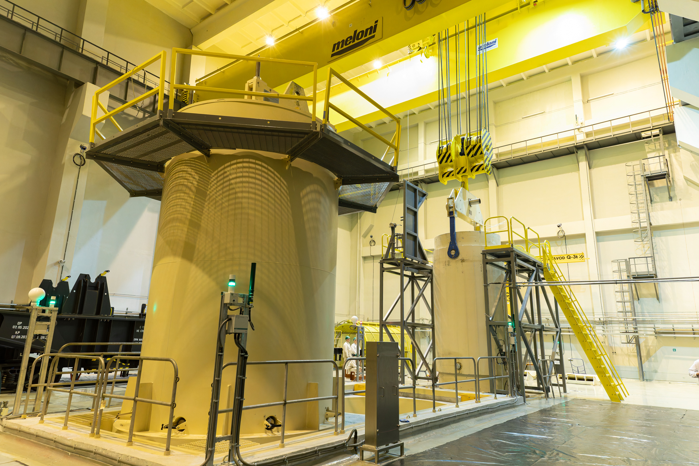
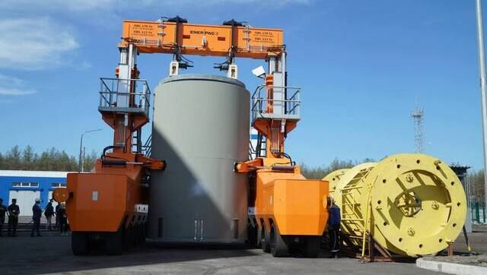
CENTRALIZED SPENT NUCLEAR FUEL STORAGE FACILITY
The main approach includes the following stages:
Stage 1. The equipment transportation to and technological operations at the NPP.
Stage 2. HI-STAR transportation to the facility by specialized railway train.
Stage 3. Technological operation at the facility with MCPs reloading to HI-STORMs.
Stage 4. Installation of HI-STORMs for the long-term storage.
13

Slide 14
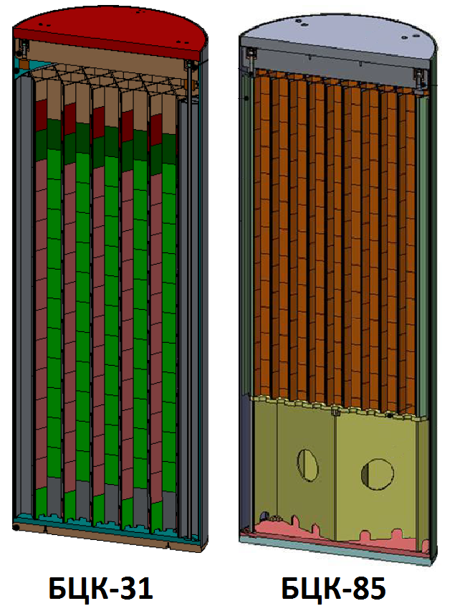
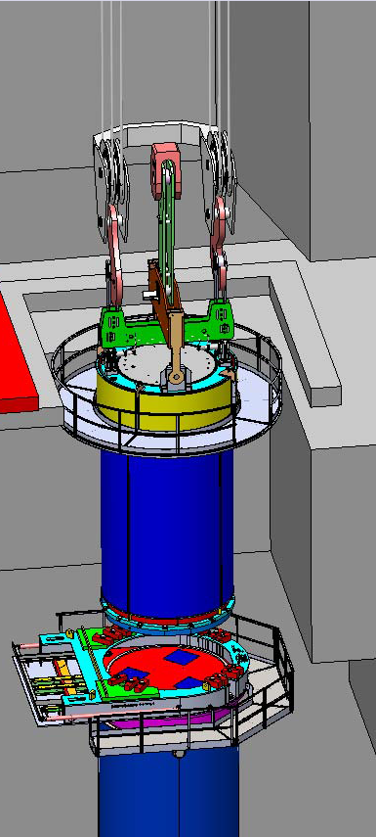
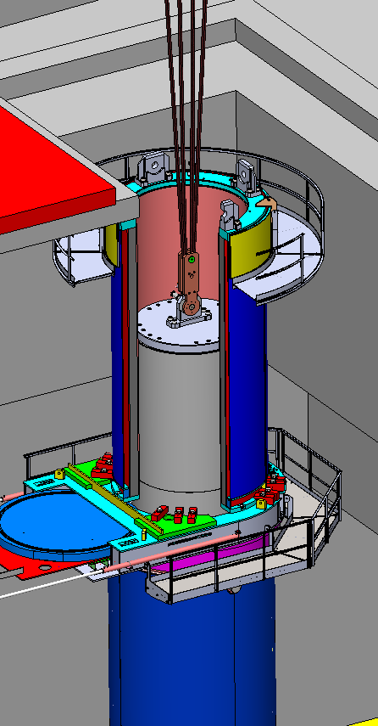
CENTRALIZED SPENT NUCLEAR FUEL STORAGE FACILITY
STAGE 1
Spent nuclear fuel (SNF) is loaded into a multi-purpose canister (MPC). Two types of MPCs are applied: MPC-31 – for 31 SFAs of VVER-1000 and MPC-85 – for 85 SFAs of VVER-440.
Loaded MPCs are hermetically sealed and dried. MPCs are transferred from HI-TRACKs to HI-STARs, which are located on special railcars.
MPC-31
MPC-85
14

Slide 15
CENTRALIZED SPENT NUCLEAR FUEL STORAGE FACILITY
STAGE 2
The delivery of spent nuclear fuel from NPP to the facility is carried out by rail transport.
Screw
Lid
Inspection port
Flange
Lifting pin
Shell
Bottom forging
15

Slide 16
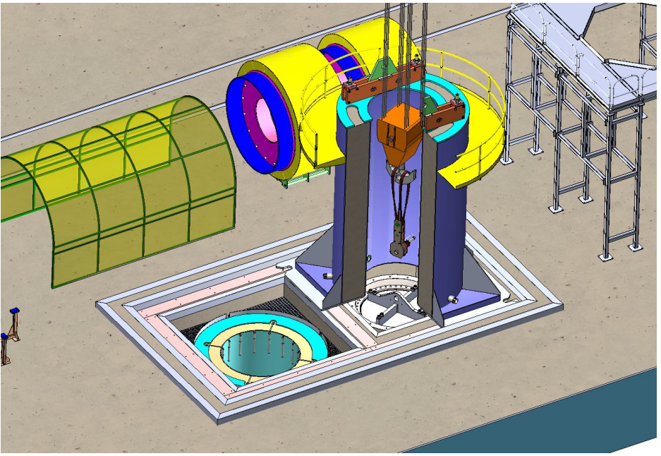
CENTRALIZED SPENT NUCLEAR FUEL STORAGE FACILITY
STAGE 3
After the train arrival to the facility, the special railcar with the HI-STAR is transported to the Receiving building.
In the building the HI-STAR is placed into a special node for reloading the MPC from the HI-STAR to the HI-STORM.
16

Slide 17
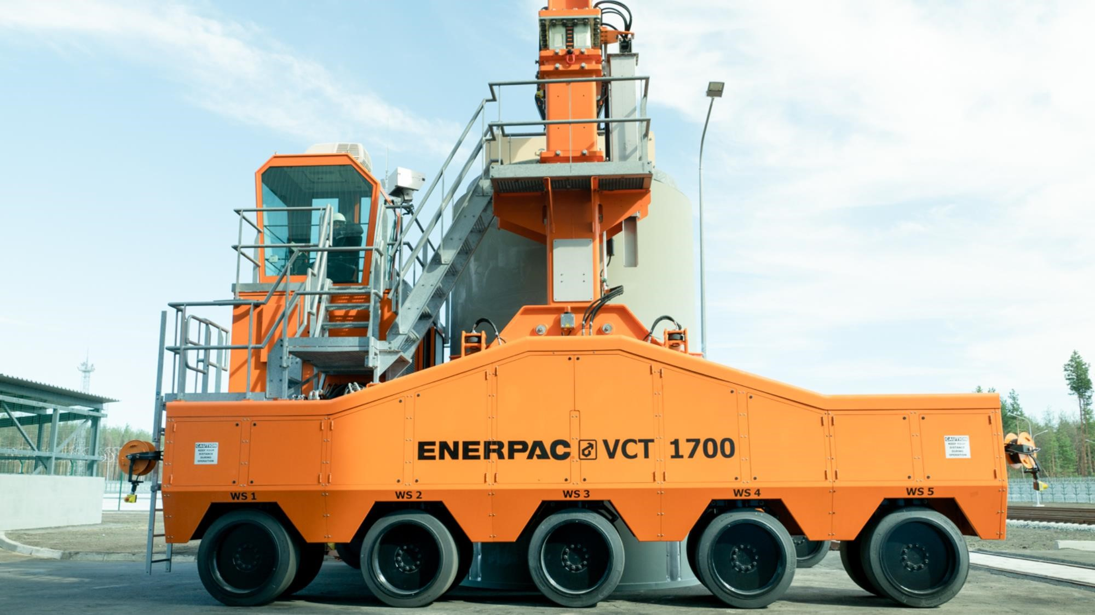
CENTRALIZED SPENT NUCLEAR FUEL STORAGE FACILITY
STAGE 4
Installation of a HI-STORM for the long-term storage is performed with a specialized container carrier.
17

Slide 18
CONCLUSIONS
A review of global experience in the field of spent nuclear fuel management does not currently allow for an indisputable choice of a single promising strategy that would best meet the needs of any country.
The solution to the problem in a particular country should largely be found in the strategies for organizing the nuclear fuel cycle, and this, in turn, depends on national priorities and the energy development program.
Ukraine's current spent nuclear fuel management strategy is focused on deferred solution (interim dry storage), aiming for long-term storage within the country and excluding its historical dependence on russia for reprocessing and storage.
Energoatom's spent nuclear fuel management represents a significant move towards self-sufficiency and strategic independence within a challenging geopolitical environment, while laying the groundwork for eventual permanent disposal solutions.
18

Slide 19
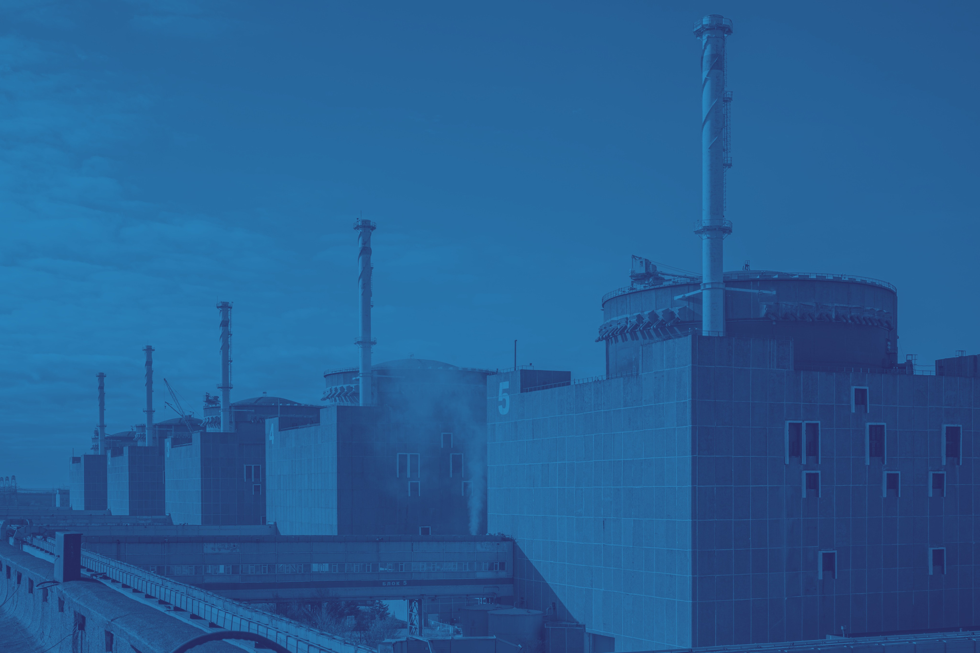

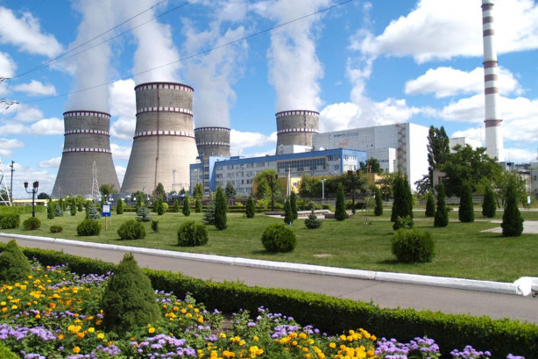
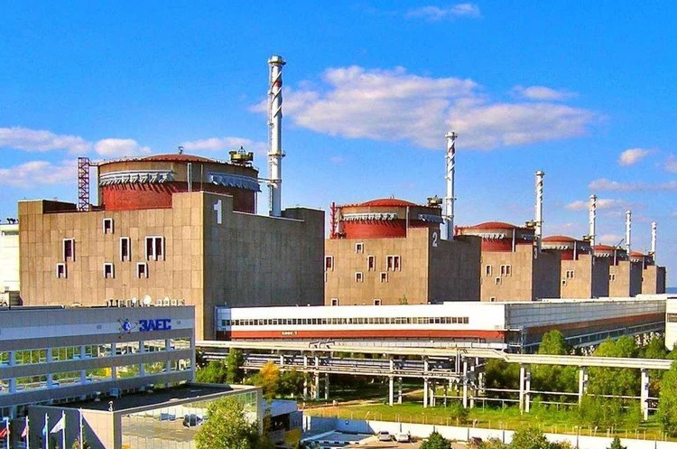
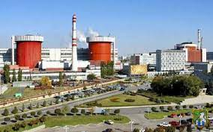
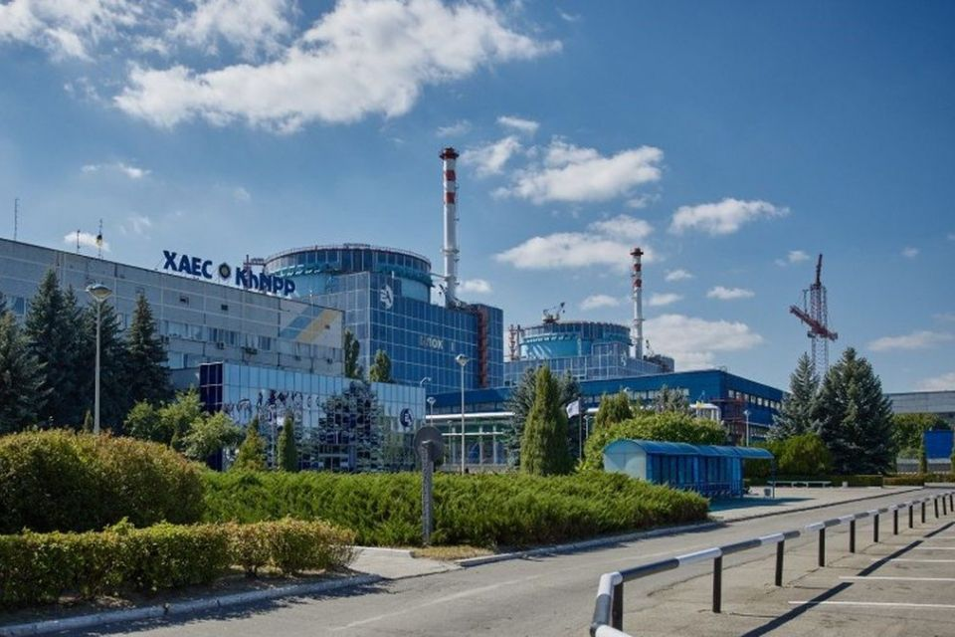
STAND WITH UKRAINE
Thank you very much for your attention!

